Slide 1
Test Characteristic Curves, Information Functions and SEM Functions
EDUC 8720

Slide 2
Test Characteristic Curves

Slide 3
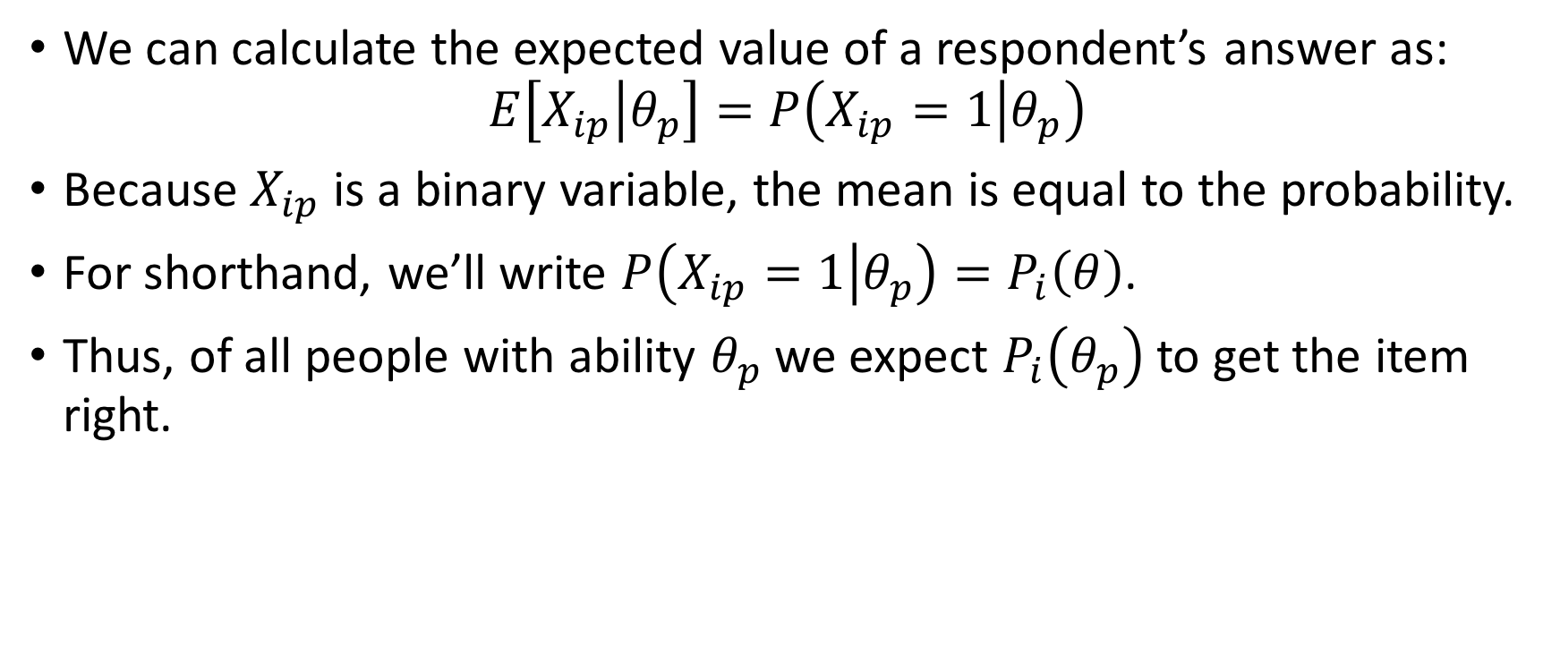
Expected Item Response
We can calculate the expected value of a respondent’s answer as:
$$E\left[X_{ip} | θ_{p}\right]=P\left(X_{ip}=1 | θ_{p}\right)$$
Because $X_{ip}$ is a binary variable, the mean is equal to the probability.
For shorthand, we’ll write $P\left(X_{ip}=1 | θ_{p}\right)=P_{i}\left(θ\right)$.
Thus, of all people with ability $θ_{p}$ we expect $P_{i}\left(θ_{p}\right)$ to get the item right.

Slide 4
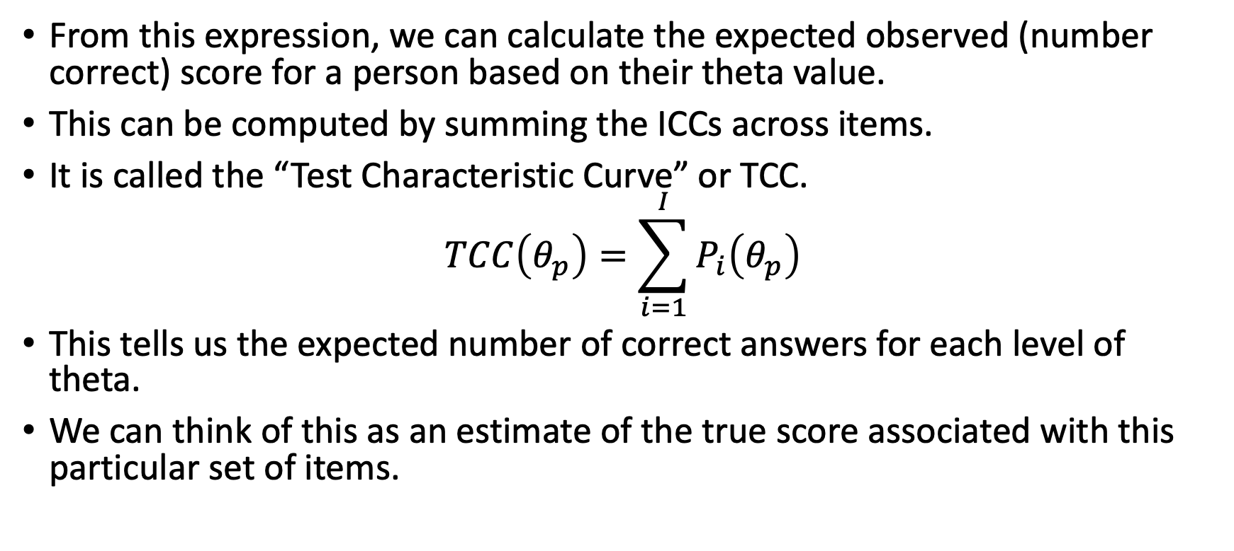
Expected Test Score
From this expression, we can calculate the expected observed (number correct) score for a person based on their theta value.
This can be computed by summing the ICCs across items.
It is called the “Test Characteristic Curve” or TCC.
$$TCC\left(θ_{p}\right)=\sum_{i=1}^{I}{P_{i}\left(θ_{p}\right)}$$
This tells us the expected number of correct answers for each level of theta.
We can think of this as an estimate of the true score associated with this particular set of items.

Slide 5
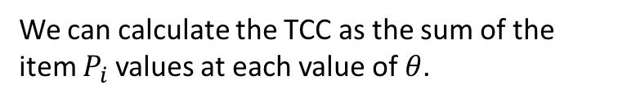
TCC for the three_item_test.xlsx Data
We can calculate the TCC as the sum of the item $P_{i}$ values at each value of $θ$.

Slide 6
Test and Item Information

Slide 7
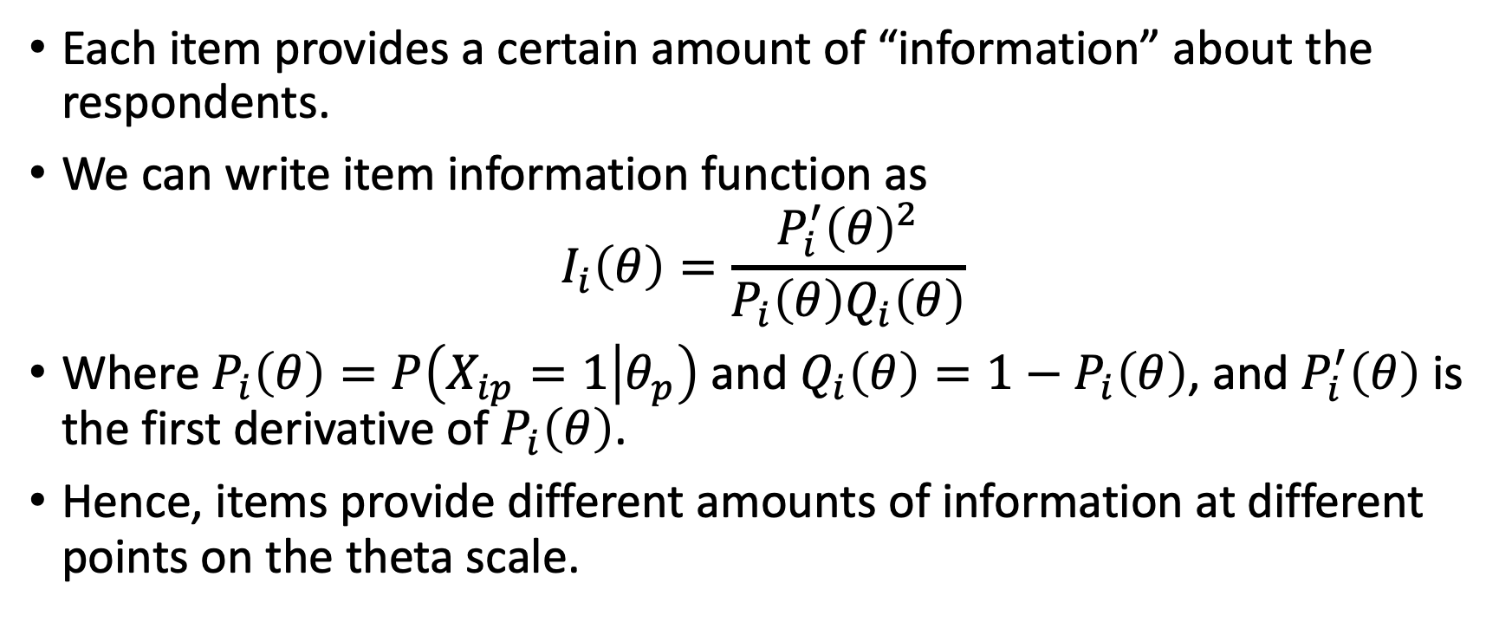
Item Information
Each item provides a certain amount of “information” about the respondents.
We can write item information function as
$$I_{i}\left(θ\right)=\frac{P_{i}^{′}{\left(θ\right)}^{2}}{P_{i}\left(θ\right)Q_{i}\left(θ\right)}$$
Where $P_{i}\left(θ\right)=P\left(X_{ip}=1 | θ_{p}\right)$ and $Q_{i}\left(θ\right)=1−P_{i}\left(θ\right)$, and $P_{i}^{′}\left(θ\right)$ is the first derivative of $P_{i}\left(θ\right)$.
Hence, items provide different amounts of information at different points on the theta scale.

Slide 8
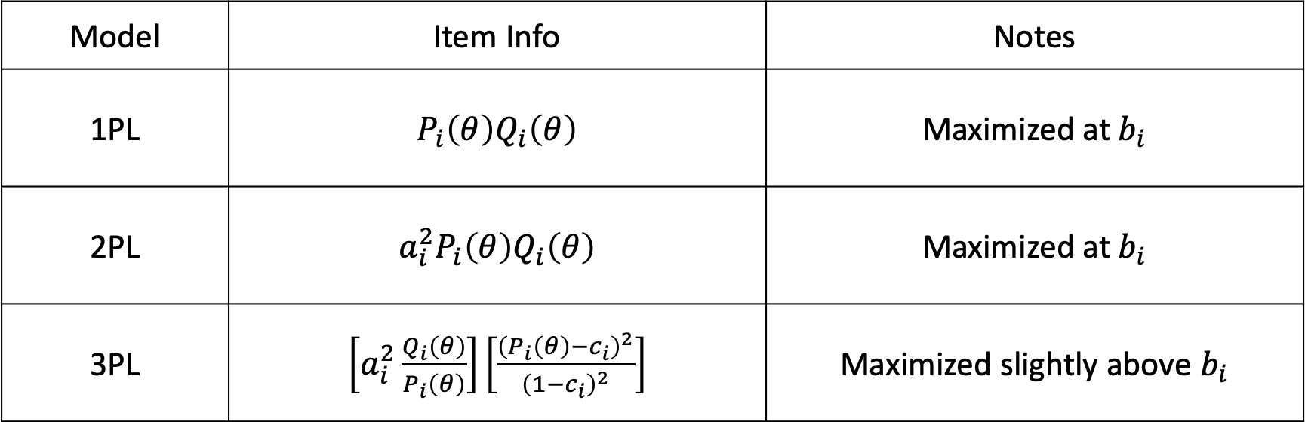
Item Information Functions
Model | Item Info | Notes
1PL | $P_{i}\left(θ\right)Q_{i}\left(θ\right)$ | Maximized at $b_{i}$
2PL | $a_{i}^{2}P_{i}\left(θ\right)Q_{i}\left(θ\right)$ | Maximized at $b_{i}$
3PL | $\left[a_{i}^{2}\frac{Q_{i}\left(θ\right)}{P_{i}\left(θ\right)}\right]\left[\frac{{\left(P_{i}\left(θ\right)−c_{i}\right)}^{2}}{{\left(1−c_{i}\right)}^{2}}\right]$ | Maximized slightly above $b_{i}$

Slide 9
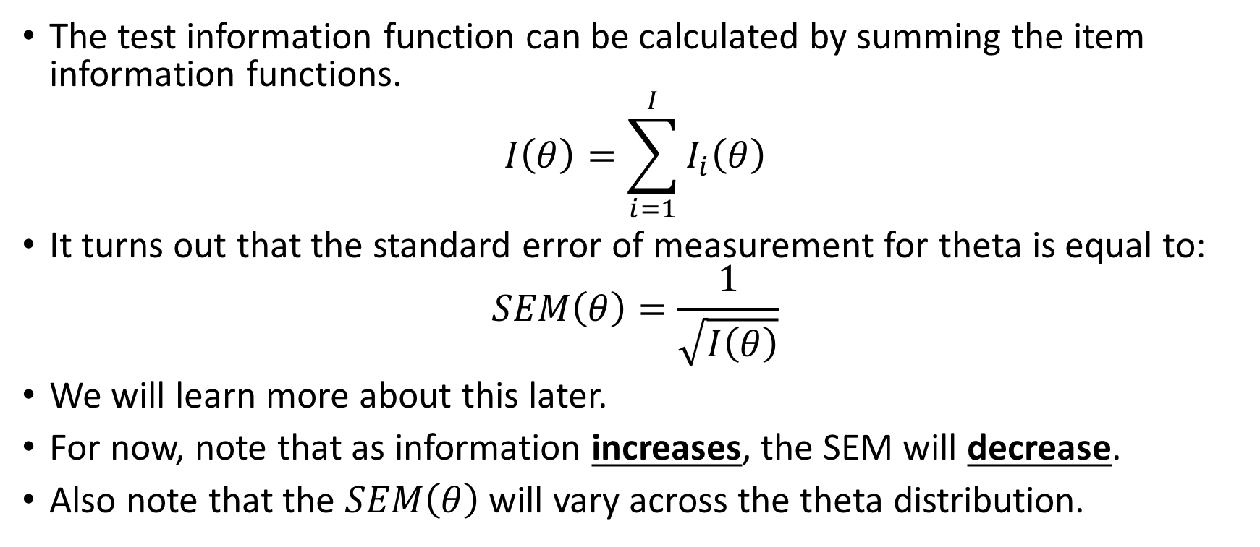
The Test Information Function
The test information function can be calculated by summing the item information functions.
$$I\left(θ\right)=\sum_{i=1}^{I}{I_{i}\left(θ\right)}$$
It turns out that the standard error of measurement for theta is equal to:
$$SEM\left(θ\right)=\frac{1}{\sqrt{I\left(θ\right)}}$$
We will learn more about this later.
For now, note that as information increases, the SEM will decrease.
Also note that the $SEM\left(θ\right)$ will vary across the theta distribution.

Slide 10
Item and Test Info for the three-item-test

Slide 11
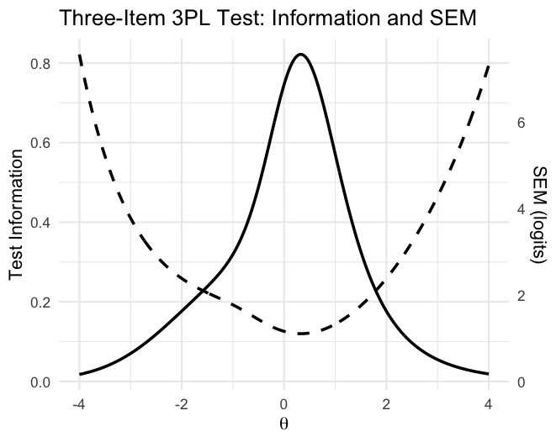
Comparing Test and SEM Functions
See “Test_info_SEM_Fcns.R”
Script created using following prompt to ChatGPT 5.2
The tab labelled "threeitems" in the uploaded spreadsheet contains the item parameters for three test items that were fit to the 3PL IRT model. Use R to produce a plot that shows the test information function and SEM function for this three item test. The left axis of the plot should show information units, the righthand side logits for SEM units.

Slide 12
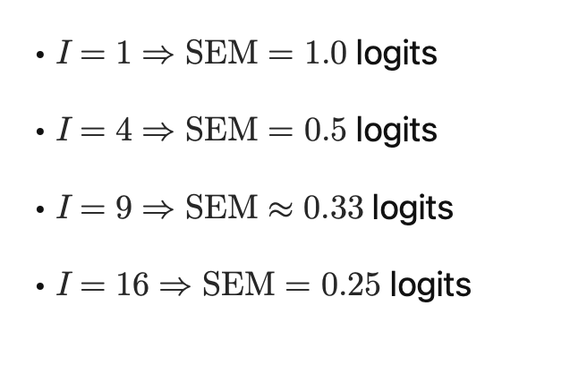
A Crib Sheet for Test Info values…
It’s typically the case that the SD of the theta distribution is constrained to be 1. In most large-scale standardized tests, we expect to have information at most locations of the theta that is at least = 9 or about .3.

Slide 13
Using Test and Item Information Practically
Item information and test information are especially useful for constructing tests.
Can use item and test information to predict SEM of theta scores.
Can selectively increase information at different points in the theta distribution.

Slide 14
Practice using mirt with Real Data
Let’s use mirt to produce a TCC, Item and Test Information Functions and an SEM Function with our Form A Data
Go to ”part 4” of the R Markdown file “TCC_Information_SEM.html”
Makes use of the mirt() package in R.

